Slide 1
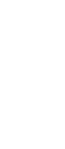
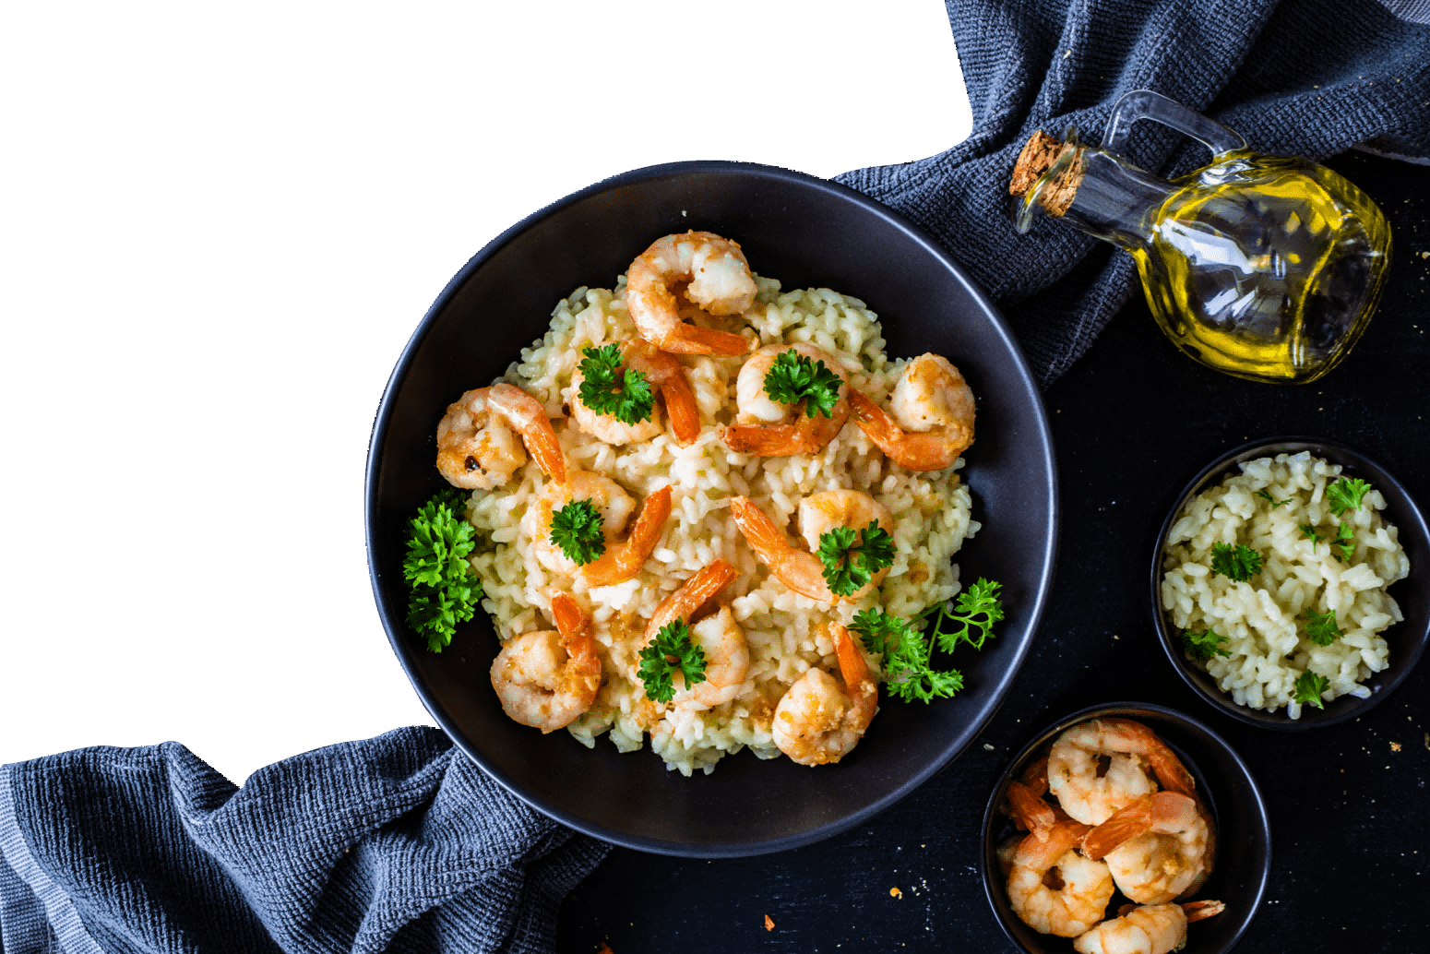
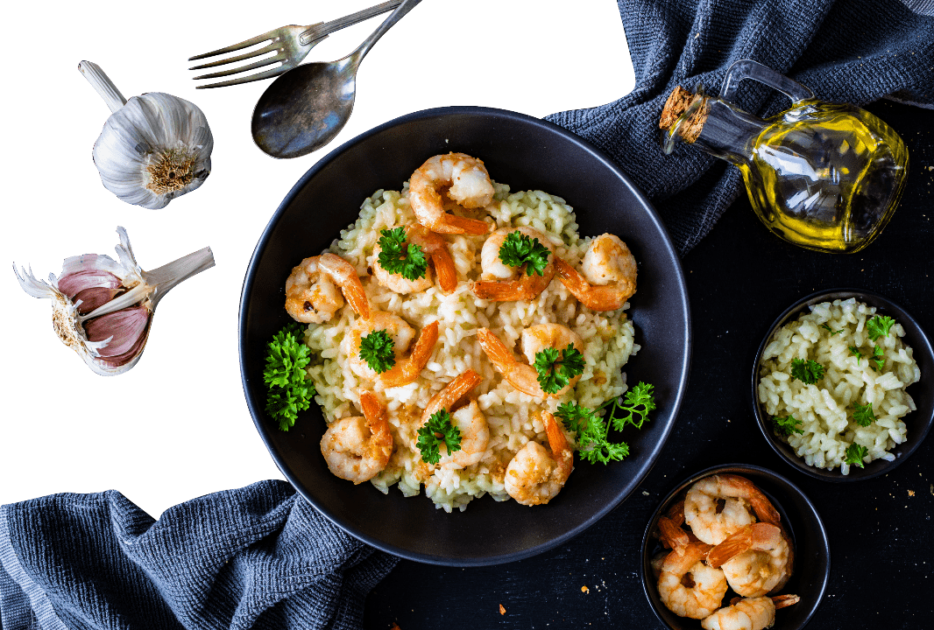
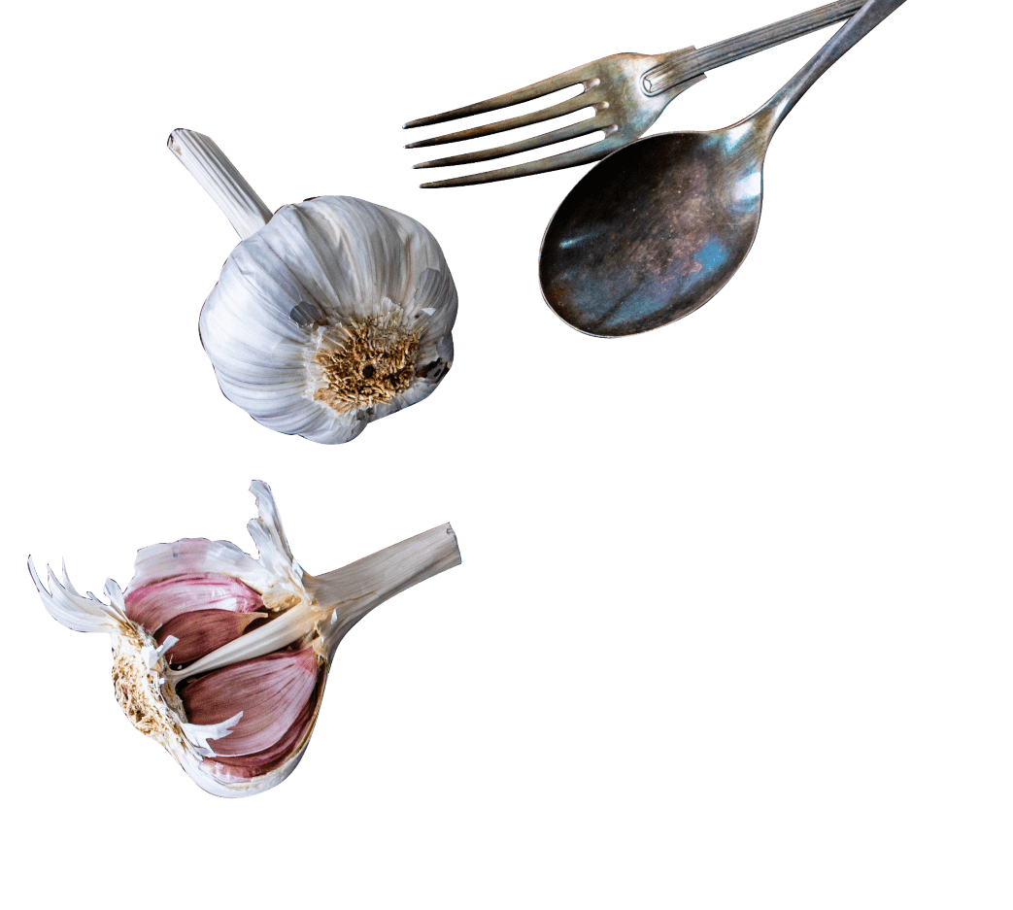
Restaurant
Ordering System
02

Slide 2
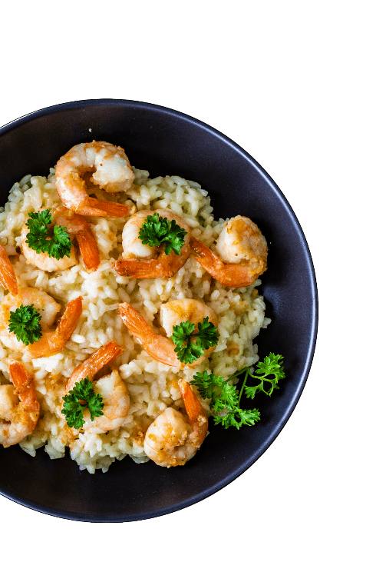

CONTENTS
01.
01
02.
02
Introduction
Diagrams
03.
03
04.
04
Benefits & Solutions
ROI
.

Slide 3
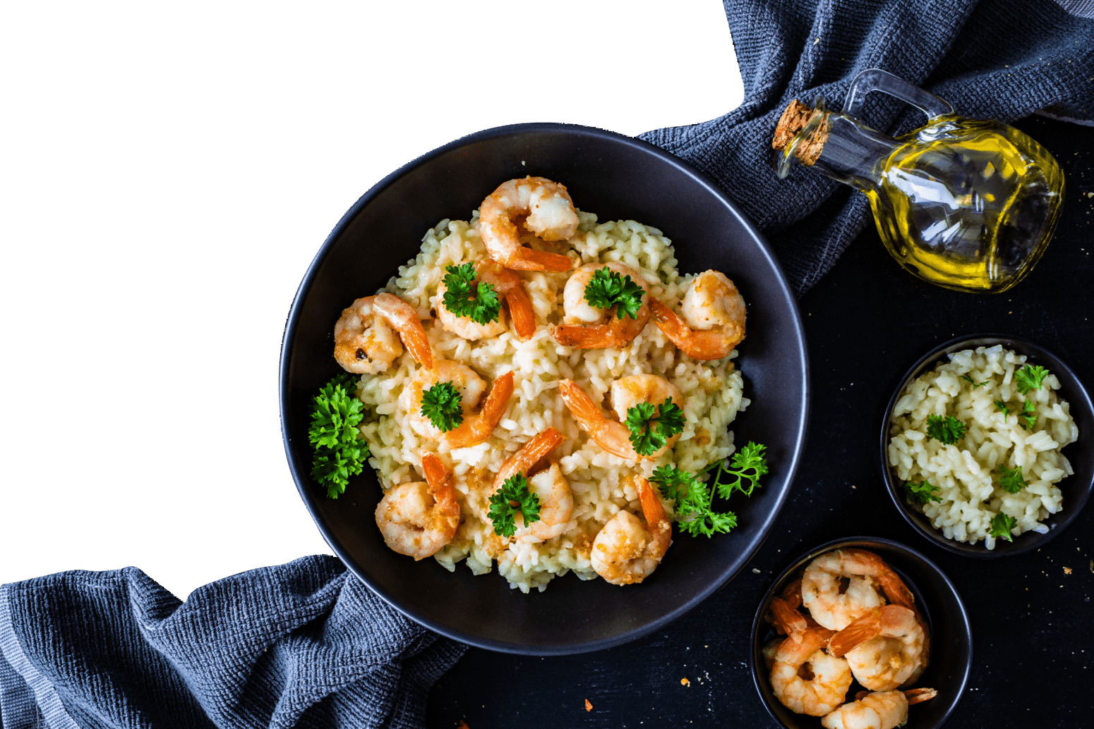
01.
Introduction
Restaurant ordering system is most type of systems spread in world so each restaurant seek to make own system to compete among restaurants.
01

Slide 4
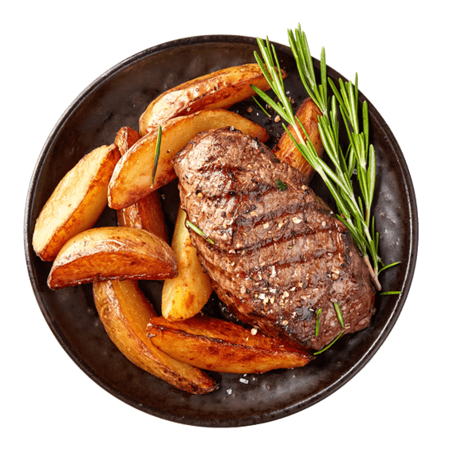
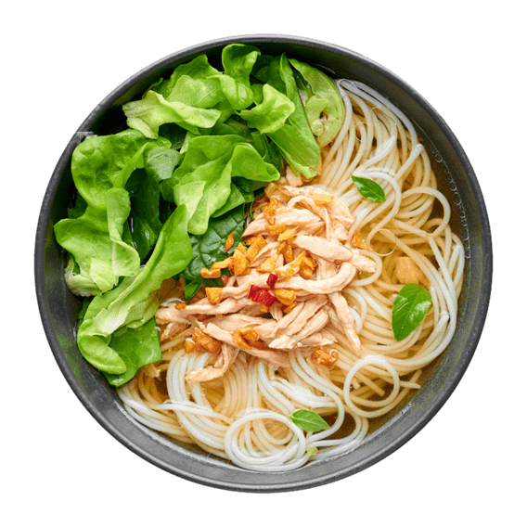
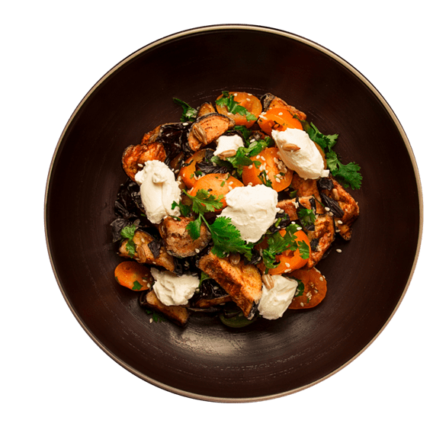
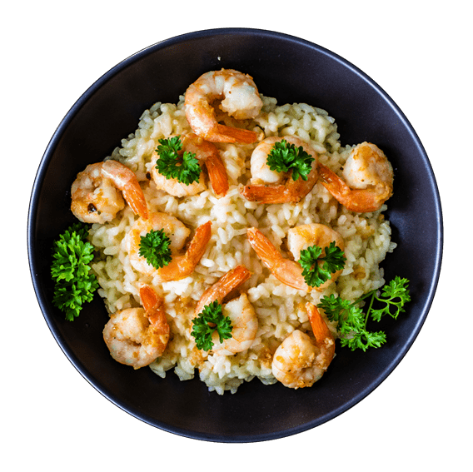
What is the challenges?
Menu Management
Order Accuracy
Integration with Existing Systems
Clear Order

Slide 5
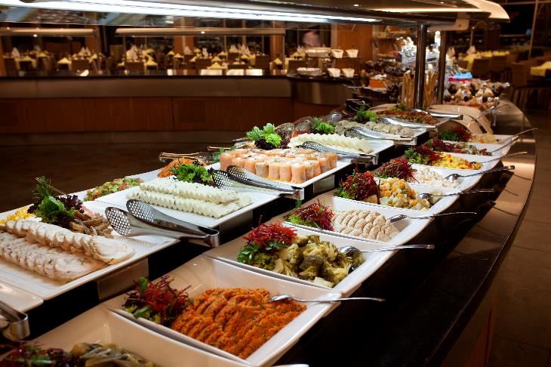
What is the first step ?
Clear Requirements
To achieve clear requirements, an accurate and detailed analysis of these requirements must be carried out through a process of (Requirement Analysis)
Through this process, we return the unclear requirements to the customer again to obtain more accurate requirements.

Slide 6
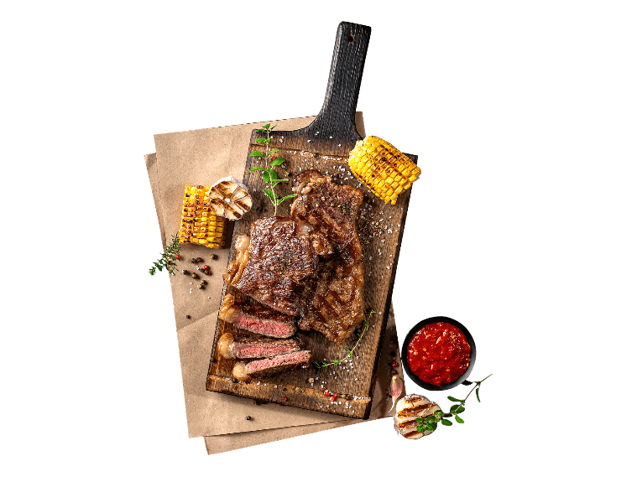
Dealing with challenges
Menu management
Managing a dynamic menu with frequent updates, additions, and removals can be complex, especially for restaurants with seasonal or daily specials.
Order Accuracy
Maintaining order accuracy is crucial to customer satisfaction. Any discrepancies between what customers order and what is delivered can lead to dissatisfaction and complaints.
Integration Challenges
Integrating the ordering app with existing promo code (discount ) systems, inventory management software, and third-party delivery services can be complex..

Slide 7

02.
Diagrams
To show how the System work & what is the expected output .

Slide 8
UML
Diagram

Slide 9
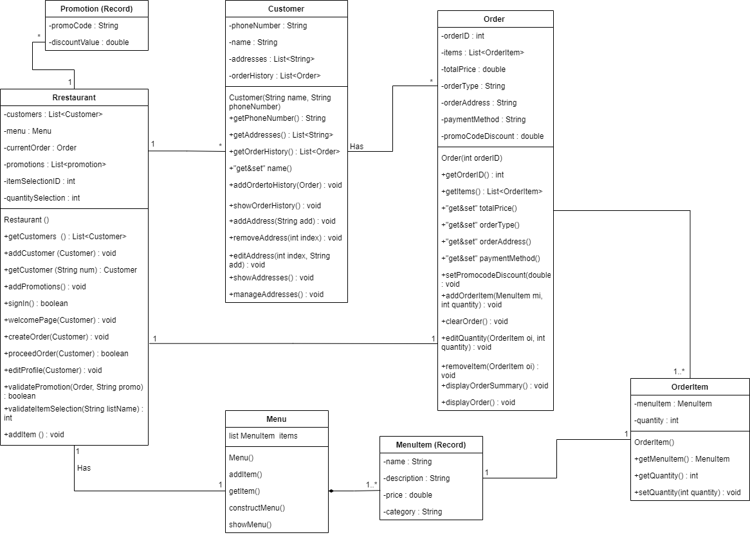

Slide 10
Program
Flow chart

Slide 11
Program Live Demo

Slide 12
03.
Benefits & solutions
For each challenge have benefit and solution

Slide 13
Benefit & Solution for each challenge
One of the most important reasons that makes any project succeed is finding problems that this project can solve
Integration with Existing Systems
Menu Management
Order Accuracy
Benefits: Consistent and up-to-date menu information across all platforms, improved customer satisfaction.
Solutions: Implement a centralized menu management system that allows for easy updates. Use cloud-based software for real-time synchronization.
Benefits: Enhanced customer satisfaction, reduced order errors, positive reviews.
Solutions: Implement order confirmation screens to review orders before submission. Provide clear instructions and options for customization. Monitor order accuracy and address any issues promptly.a short description
Benefits: Streamlined operations, improved data accuracy, better decision-making.
Solutions: Choose a flexible ordering system that offers easy integration with existing systems. Work closely with software vendors or third-party developers to customize integrations as needed.

Slide 14
04.
01
ROI
02
03
04

Slide 15
Cost / Benefit | Year 1 | Year 2 | Year 3 | Year 4 | Year 5 | Total
Development Costs | 50,000
Infrastructure Costs | 10,000
Operational Costs | 20,000 | 20,000 | 20,000 | 20,000 | 20,000 | 100,000
Marketing Costs | 15,000 | 15,000 | 10,000 | 10,000 | 10,000 | 55,000
Other Costs | 5,000 | 5,000 | 5,000 | 5,000 | 5,000 | 25,000
Total Costs | 100,000 | 35,000 | 35,000 | 35,000 | 35,000 | 240,000
Revenue | 100,000 | 110,000 | 120,000 | 130,000 | 140,000 | 600,000
Cost Savings | 15,000 | 15,000 | 15,000 | 15,000 | 15,000 | 75,000
Total Benefits | 115,000 | 125,000 | 135,000 | 145,000 | 155,000 | 675,000
Net Profit | 15,000 | 90,000 | 100,000 | 110,000 | 120,000 | 435,000
ROI | 15% | 257.14% | 285.71% | 314.29% | 342.86% | 181.25%

Slide 16
Summary
Improved operational efficiency, enhanced customer experience, streamlined operations, increased revenue, reduced errors, improved data accuracy, customer loyalty, positive reputation. Solutions include comprehensive training, user-friendly software, incentives for customer adoption, and effective customer
Addressing these challenges with the corresponding benefits and solutions can lead to a successful implementation of a restaurant ordering system, driving efficiency, satisfaction, and growth.
Future enhancements:
Online payment
Recording
Ratings
Order tracking

Slide 17
THANK
YOU!

